Slide 1
Insurance Premium Prediction

Slide 2
Objective:
The goal of this project is to give people an estimate of how much they need based on their individual health situation. After that, customers can work with any health insurance carrier and its plans and perks while keeping the projected cost from our study in mind. This can assist a person in concentrating on the health side of an insurance policy rather han the ineffective part.
Benefits:
Predict the estimate price to spend on Insurance Premium
Gives better understanding of available Insurance Plans
Helps by concentrating on the health side of an Insurance

Slide 3
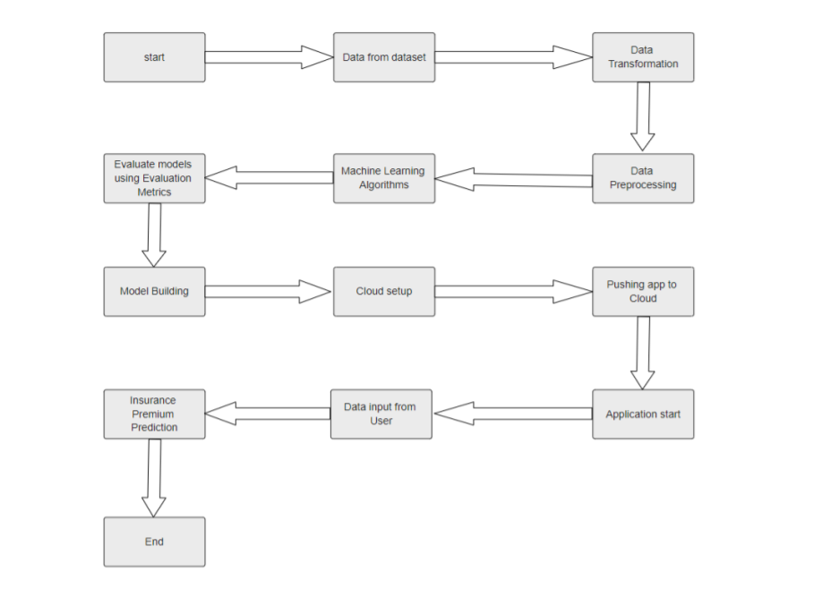
Architecture

Slide 4
Data Validation and Transformation:
Data Type validation: The data type of Input features is specified in the Machine Learning model. It is validated when we enter values in the Web UI.
Categorical Conversion: The Categorical features are converted into Numerical values using ‘Label Encoding’ or ‘One Hot Encoding’ methods.

Slide 5
Model Training:
Data Export from source :
The accumulated data from source is exported in csv format for model training
Data Preprocessing
Performing EDA to get insight of data like identifying distribution , outliers ,trend among data, etc
Check for null values in the columns. If present impute the null values.
Encode the categorical values with numeric values.
Perform Robust Scalar to scale down the values.

Slide 6
Regression–
Regression is a Statistical Technique which is used to find out the relationship between a continuous dependent variable an one or more independent variables.
The technique is applicable for Supervised Learning problems where we compare our predicted values with observed values.
In this project, we use following Regression Algorithms:
Linear Regression
Polynomial Regression
Ridge Regression
Decision Tree Regression
Random Forest Regressor
Model Selection-
After the models are trained, we find the best fitting model for our data. For each model, hyperparameters are tuned (where needed).
We calculate the R2 score, k-fold Cross Validation score and Root Mean Square Error Value for every model and select the best fitting model for production.

Slide 7
Prediction:
The testing files are shared in the batches and we perform the same Validation operations ,data transformation and data insertion on them.
The accumulated data from source is used for prediction
We perform data pre-processing techniques on it.
Random Forest Regressor model created during training is loaded
The model is loaded and is used to predict the data based on User Input data gathered through the Web UI
Once the prediction is done , the predictions are displayed in the Web UI.

Slide 8
Q & A:
Q1) What’s the source of data? Ans 1. The data for training is collected from here
Q 2) What was the type of data?
Ans 2. The data was the combination of numerical and Categorical values.
Q 3) What’s the complete flow you followed in this Project?
Ans 3. Refer slide 5th for better Understanding
Q 4) After the Input validation what you do with invalid user input?
Ans 4. Upon validation, if invalid input is detected from the User’s end, the user is redirected to a web page with an appropriate error message

Slide 9
Q 5) How logs are managed?
Ans 5.We are using different logs as per the steps that we follow in validation and
modeling like File validation log , Data Insertion ,Model Training log , prediction log
etc.
Q 6) What techniques were you using for data pre-processing?
Removing unwanted attributes
Visualizing relation of independent variables with each other and target variables
Checking and changing Distribution of continuous values
Removing outliers
Cleaning data and imputing if null values are present.
Converting categorical data into numeric values.
Scaling the data

Slide 10
Q 7) How Prediction was done?
Ans 7. The User Input gathered through the Web UI is fed into the trained Machine Learning model. The model makes the prediction and the User is redirected to a web page displaying the predicted value. Q 8) How Training was done or what models were used? 1. Before training the model, the dataset is divided into training into training The User Input set and a testing/validation set. 2.The scaling was performed of training and validation set. 3.The categorical columns were converted into numerical values. 4.Algorithms like Linear regression, Decision tree, Random forest and gradient boosting were used for model training. Based on RMSE and r2 score the gradient boosting regressor model was selected for GridSerach CV for best parameters after the hypertuning model was saved for Validation. Q9.What are the different stages of deployment? Ans 9. After the model is ready, we deployed it on Heroku platform.

Slide 11
THANK YOU ☺ BY: MEGHA SINGHAL

